Slide 1



Welcome to Induction Skills Bootcamp

Slide 2

Induction objectives?
Learners will understand the implications of the following:
Equal opportunities and diversity policy
Complaints policy
Reasonable adjustment & special considerations policy
Code of conduct guidance
British values
Prevent duty
Safeguarding duty
Attendance requirements
Assessment requirements
Careers support on offer
Certification process
Learner surveys

Slide 3
Equal Opportunities and Diversity Policy
The Skills Network is committed to diversity and will promote diversity for all employees, learners and service users.
The Skills Network will treat everyone equally and will not discriminate on the grounds of an individual’s ‘protected characteristic’ under the Equality Act 2010 (the Act) which are; age, disability, gender reassignment, marriage and civil partnership, pregnancy and maternity, race, religion or belief, sex, and sexual orientation.

Slide 4
The policy aims to ensure that all individuals and groups
1. Are treated fairly and with respect in all interactions with them.
2. Have the right to be free from harassment and bullying of any description.
3. Do not suffer unwanted behaviour, whether based on age, disability, transgender status, marital
status, civil partnership status, pregnancy, race, religion or belief, sex or sexual orientation.
4. Have an equal chance to contribute to achieve their potential, irrespective of any defining feature that may give rise to unfair discrimination.
5. Can engage with an organisation that complies fully with the Prevent Duty, and who takes active steps to equip staff and learners with an understanding of Radicalisation, Extremism, and Fundamental British Values

Slide 5
Complaints Policy
At The Skills Network, we are committed to providing high quality services for our service users, taking account of users’ views and using the findings to promote and develop capacity for sustainable improvement.
Making a Complaint
Formal complaints can be made in the following ways: By telephone – 01757 210522. By email – complaints@theskillsnetwork.com. In writing – The Skills Network, Abbey Court, 6-16 Benedict Drive, Selby, North Yorkshire, YO8 8RY.

Slide 6
Reasonable Adjustment & Special Considerations Policy
A reasonable adjustment is any action that helps to reduce the effect of a disability or difficulty that places the Learner at a substantial disadvantage. The Skills Network are required to do what is ‘reasonable’ in terms of allowing an adjustment, and what is considered reasonable will depend on the individual needs of the Learner, cost implications and the practicality and effectiveness of the adjustment.

Slide 7
Skills Bootcamp code of conduct
The code of conduct is designed to ensure you have a positive experience on your Skills Bootcamp course.
Please note as all sessions are recorded thus you must ensure that you apply a virtual background to avoid filming other people that have not agreed to be filmed.
If you have not already done so, select your camera and set your background.
This is a key safeguarding requirement for your participation on the course.

Slide 8
Code of conduct
Set your virtual background
Be on time: Just like in a physical classroom, it's important to be punctual for your online class. Log in to the virtual classroom a few minutes before the class starts.
Turn Cameras on: In order to maximise your learning studies show that being able to see your peers and your tutor being able to see you can increase motivations and retention, therefore we ask to keep your cameras on.
Attend all classes: In order to be successful in your bootcamp studies you need to attend all live sessions, therefore you should prioritise and make time for these sessions.
Avoid distractions: Turn off your phone notifications, close any other unnecessary tabs, and focus solely on the class.
Participate actively: It's important to be an active participant in the class. Ask questions, answer questions, and participate in discussions.
Use proper language and tone: Use respectful language and tone when communicating with your classmates and instructor. Avoid using slang or inappropriate language.

Slide 9
Code of conduct
Respect others' opinions: Be respectful of others' opinions, even if they differ from your own. Avoid making negative comments or attacking others.
Follow the instructor's guidelines: Follow the instructor's guidelines, such as submitting assignments on time.
Be polite: Be polite and respectful to everyone in the class, including the instructor, classmates, and guest speakers.
Dress appropriately: Even though you are not in a physical classroom, it's important to dress appropriately. Dress as if you were going to a face-to-face class.
Use appropriate technology: Ensure that you have the necessary equipment, such as a reliable internet connection, a microphone, and a webcam, and that they are in good working condition.
Do not share your personal data: Ensure you do not share any personal data such as your address, personal email whilst in the live sessions.

Slide 10
British Values
Democracy: making decisions together, for example giving opportunities to develop minds in an atmosphere where questions are valued.
Rule of law: understanding rules matter for example collaborating with everyone to create rules and codes of behaviour.
Individual liberty: freedom for all, for example reflecting on their differences and understanding we are free to have different opinions
Mutual respect and tolerance: treat others as you want to be treated, for example sharing and respecting other’s opinions.
https://www.youngcitizens.org/resources/citizenship/british-values/

Slide 11
Prevent
The Prevent Law came into force in 2015. Educational providers must have due regard to the need to prevent people being drawn into terrorism.
The government has defined extremism in the Prevent strategy as: “vocal or active opposition to fundamental British Values, including democracy, the rule of law, individual liberty and mutual respect and tolerance of different faiths and beliefs."
In education it means that we must demonstrate that they are protecting people from being drawn into terrorism by having robust safeguarding policies.

Slide 12
What do we mean by the term safeguarding?

Slide 13
Safeguarding adults is defined
protecting the rights of adults to live in safety, free from abuse and neglect.
people and organisations working together to prevent and stop both the risks and experience of abuse or neglect.
people and organisations making sure that the adult’s wellbeing is promoted including, where appropriate, taking fully into account their views, wishes, feelings and beliefs in deciding on any action.
recognising that adults sometimes have complex interpersonal relationships and may be ambivalent, unclear or unrealistic about their personal circumstances and therefore potential risks to their safety or well-being.

Slide 14

Safeguarding

Slide 15
safeguarding issues
If you feel you need advice regarding any safeguarding issues, speak or email your tutor.
You can also contact the Safeguarding Team
Email safeguarding@theskillsnetwork.com
Tel: 01757 210 022

Slide 16
Attendance
You are required attend every session to pass your course.
If you miss a session, you must attend an alternative relevant session or if none are available, you must view the missed session and confirm you have met the objectives of the session.
Email skills.bootcamps@theskillsnetwork.com
Please cc your tutor when you do so.
Failure to attend can put your place on the course at risk.

Slide 17
Assessments
You are required to complete your assessments on time and to an appropriate standard to pass your course.
If you are required to resubmit an assessment, please ensure you do so within 7 days.
Failure to submit your assessments can put your place on the course at risk.

Slide 18
Personal tutors
As a part of your course, you will be assigned your own personal tutor to assist you on your learning journey.
You will be invited to at least three 1 to 1 meetings, the meetings will allow you to reflect on your progress and address any barriers you may be facing. .

Slide 19
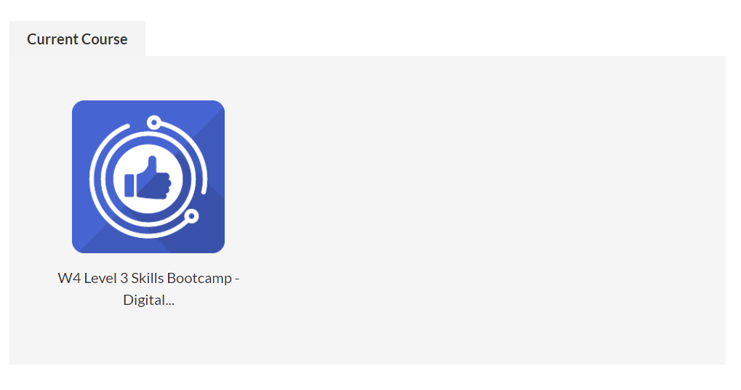
Assessment submissions
First to access the booklets you need to click into your current course

Slide 20
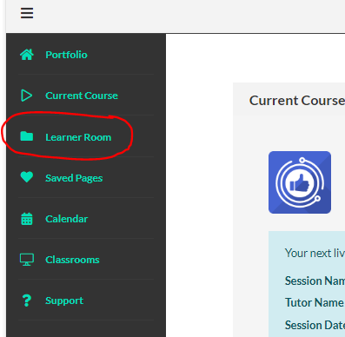

Next you will want to click into the Learner Room tab on the left-hand side.

Slide 21
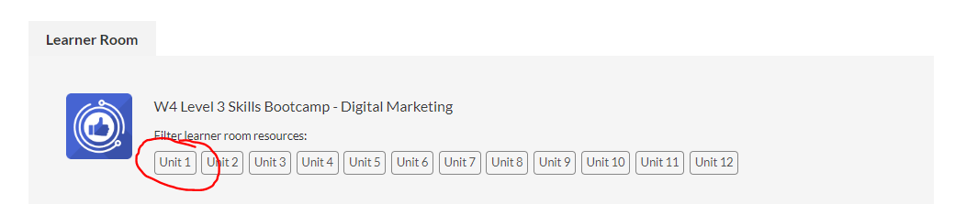
Next select Unit 1

Slide 22
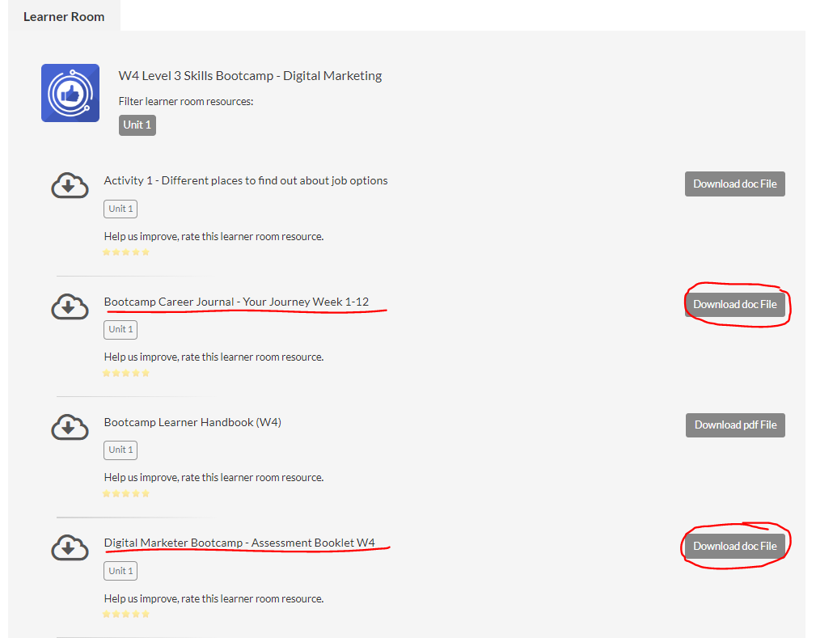
From this page you will want to
download both the Career Journal and your Sector Specific assessment booklet

Slide 23
Career workshops
At The Skills Network, we offer numerous virtual workshops, where you can learn lots of top tips to help you towards your career goals.
The workshops are virtual and will take place during your live online learning sessions
The workshops are designed with learners’ employment status in mind to ensure the information covered is relevant to your goals.

Slide 24
The career team will be be contacting you
Approximately 1 month into your course, if you need to speak to a member of the team sooner call 01757600709
or email progression@theskillsnetwork.com

Slide 25
What email address can I send my CV to?
progression@theskillsnetwork.com
Please send your CV to above and your tutor at the start of your course.
The careers team will annotate your CV with helpful advice and feedback!
When sending your CV, please provide some context in the body of your email e.g., your name, the course you are studying and the support you would like.

Slide 26
Learning Support Advisor
Every leaner has their own Learning Support Advisor
Your LSA can provide quality 1-1 support to discuss any issues you may have.
We do this virtually via phone call/classrooms or teams.

Slide 27
Successful completion after 16 Weeks
All assessments submitted and successfully passed.
The required guided learning hours have been met.
After you complete your assessments and achieve your guided learning hours, we can send a letter of achievement.

Slide 28
Successful completion after 6 months
Certification: we need to evidence the impact of the Skills Bootcamp upon your career.
You will only receive your certificate once you have secured an interview in your chosen field and have sent us evidence of this. If you are self-employed you need to complete your Personal Development Plan on how you are going to use your learning to support your business.
If you have been enrolled on the Skills Bootcamp by your employer? We will ask your employer to contact us stating how you will be using the learning from the course in your role or how it will help to gain a promotion and when you take these extra responsibilities on or get the promotion inform us of this information for our records.

Slide 29
When will I receive my certificate after the course?
As discussed in the previous slide, you will only receive your certificate after your guaranteed interview or if you are self employed/ co funded when we have the required documents.

Slide 30
Learner surveys
Please ensure you complete each survey in order to assist us in ensuring we are responsive to your valuable feedback.
First Impressions (within 4 weeks of enrolment)
Keeping in Touch (around week 8/10)
Next Steps and Progression (sent once live learning is completed)
Destination survey (sent 3 months post achievement)

Slide 31
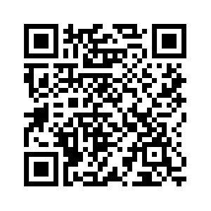
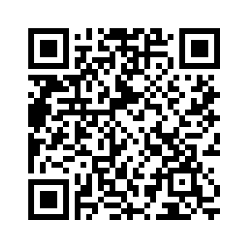
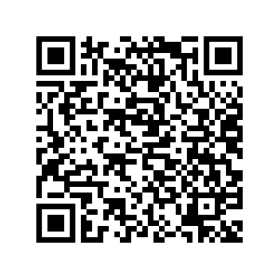
Survey links
First Impressions within 4 weeks of enrolment | https://r1.dotdigital-pages.com/p/1B3R-18NY/first-impressions-survey | To capture feedback on a learners enrolment process, IAG and intent
Keeping in Touch around week 8 – 10 | https://r1.dotdigital-pages.com/p/1B3R-17R2/keeping-in-touch-survey | To capture feedback on elements of SBC, resources, LSA and Tutor support, Safeguarding and overall experience to date
Next Steps and Exit during last live learning session | https://r1.dotdigital-pages.com/p/1B3R-17R3/next-steps-and-progression-survey | To capture impact, if intent was met and overall experience

Slide 32
Any questions?

Slide 33
Do you understand the implications of the following?
Equal opportunities and diversity policy
Complaints policy
Reasonable adjustment & special considerations policy
Code of conduct guidance
British values
Prevent duty
Safeguarding duty
Attendance requirements
Assessment requirements
Careers support on offer
Certification process
Learner surveys

